Slide 1

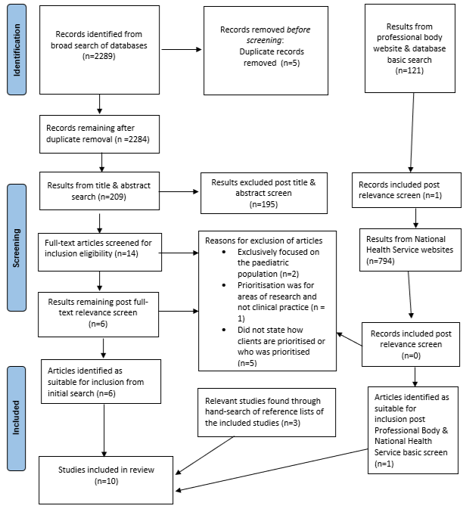
PRIORITISATION SYSTEMS USED BY SPEECH AND LANGUAGE THERAPISTS IN ADULT SETTINGS: A SCOPING REVIEW.
¹Hulbert, C; ²Cullen, R; ³McTiernan, K; ⁴Gilheaney, O. Department of Clinical Speech and Language Studies, Trinity College Dublin, Dublin, Ireland.
Background: Prioritisation is a common practice used in Speech and Language Therapy (SLT) departments as the growing demand for services often exceeds available resources. However, despite prioritisation being such a foundational clinical activity within this profession, there is minimal research available regarding methods of evidence-based for the prioritisation systems used across adult SLT settings. Therefore, there is a risk of inconsistency among current prioritisation practices due to the absence of standardised guidelines. This may lead to a lack of equitable distribution of resources, with impact on patient well-being and outcomes.
Methods: A scoping review was carried out to identify the prioritisation systems used in adult SLT settings, and to determine the facilitators and barriers to the development and implementation of effective prioritisation systems in these settings. This study was conducted in line with PRISMA-ScR guidelines (Tricco et al., 2018), with a protocol prospectively published (https://osf.io/dbtsf/).
Six academic databases, 3 professional body websites, and 2 national health service websites were searched using a multi-tiered search strategy with assistance from a subject expert librarian.
Data was charted regarding outcomes of interest and critical appraisal using study design-specific tools was completed by 2 independent researchers.
Fig. 1: PRISMA Diagram
Results: 10 studies were eligible for inclusion. Sixty percent of studies identified dysphagia as a high priority for earliest intervention, with 30% consistently prioritising dysphagia over any communication deficits due to the medical implications of unmanaged swallowing problems.
The majority did not address facilitators (60%) or barriers (80%) to developing or implementing prioritisation systems.
The absence of a standardised prioritisation system was noted throughout included studies, with clinical judgement alone, non-standardised systems, or chronological order of referral commonly used in prioritisation.
Discussion: This review provides an exploratory overview of the limited amount of existing literature on the prioritisation systems used in adult SLT settings, highlighting the lack of evidence-based or standardised systems in this field.
Further research is needed to identify the facilitators and barriers to the development and implementation of evidence-based prioritisation systems in order to identify best practice to improve patient care, experiences, and outcomes.
References:
Tricco, A. C., Lillie, E., Zarin, W., O’Brien, K. K., Colquhoun, H., Levac, D., Moher, D., Peters, M. D. J., Horsley, T., Weeks, L., Hempel, S., Akl, E. A., Chang, C., McGowan, J., Stewart, L., Hartling, L., Aldcroft, A., Wilson, M. G., Garritty, C., … Straus, S. E. (2018). Prisma extension for scoping reviews (PRISMA-SCR): Checklist and explanation. Annals of Internal Medicine, 169(7), 467–473. https://doi.org/10.7326/m18-0850
*References for included articles available on request from author

